Slide 1
Jaundice Pathophysiology
Date: 05-06-2025
Dr. Yerra Vishnu Akhil Raj Kumar
Senior Resident, AIIMS Bibinagar
MBBS- AIIMS Patna
Bio-Design Fellow- IIT Hyderabad
MD Physiology- AIIMS Raipur

Slide 2
Contents
Case Scenario
Jaundice Definition and Differential Diagnosis
Heme and Bile Pigments

Slide 3
Case Scenario

Slide 4
A 60-year-old woman presents to the outpatient department with complaints of
progressive yellow discoloration of the eyes and skin for the past 10 days, accompanied by
generalized itching and dark-colored urine. She also reports pale-colored stools and a dull
ache in the right upper quadrant of the abdomen. There is no history of fever, vomiting, or
recent travel. She has no known liver disease but mentions significant weight loss and a reduced
appetite over the past two months. She is a non-smoker and does not consume alcohol. On
examination, she appears icteric, afebrile, and hemodynamically stable. Abdominal examination
reveals mild tenderness in the right hypochondrium but no palpable mass or organomegaly. There is
no ascites or lymphadenopathy. Laboratory investigations show a total serum bilirubin of 11.2
mg/dL with a direct (conjugated) fraction of 9.4 mg/dL. Alkaline phosphatase is markedly elevated
at 780 U/L, GGT is 220 U/L, AST is 68 U/L, and ALT is 72 U/L. Urine dipstick is positive for bilirubin but negative
for urobilinogen. An abdominal ultrasound reveals a dilated biliary tree with a mass at the head of the
pancreas compressing the distal common bile duct. Based on this presentation, what is the most likely
diagnosis?

Slide 5
Jaundice definition and differential diagnosis

Slide 6
Definition
Jaundice is yellowish color (discoloration) of skin and mucous membranes due to accumulation of bile pigments in blood and their deposition in body tissues
Normal serum level
Total: 0.3-1.3 mg/dl
Direct Bilirubin: 0.1-0.4 mg/dl
Indirect Bilirubin: 0.2-0.9 mg/dl

Slide 7
Differential diagnosis
Carotenoderma
Quinacrine
It is a condition in which there is yellowish discoloration of skin due to ingestion of carotene high rich vegetables like carrot, lettuce, papaya and spinach etc.
It is an anti-malarial and anti-helminthic drug (4-37%)- skin discoloration and sclera discoloration.

Slide 8
Heme and Bile pigments

Slide 9
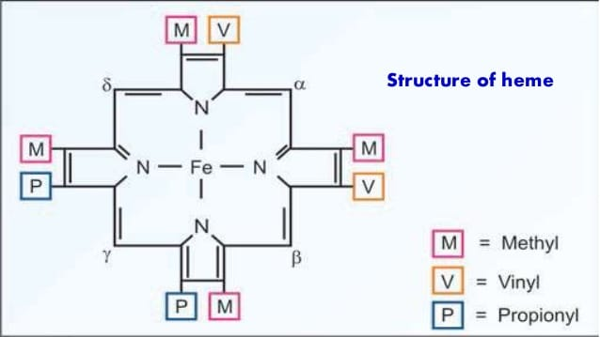
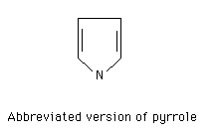
Heme

Slide 10
Heme sources
Hemoglobin: Transport of oxygen
Myoglobin: Storage of oxygen in muscle
Cytochrome C: Involvement in ETC
Cytochrome-P450: Hydroxylation of Xenobiotics
Catalase: Degradation of Hydrogen peroxidase
Tryptophan pyrrolase: Oxidation of Tryptophan

Slide 11
Bile Pigments
1 gm of hemoglobin- Yields 36.2 mg of Bilirubin
250-350 mg of Bilirubin each day from breakdown of Heme

Slide 12
Site of Breakdown- RE cells
Reticuloendothelial cells in Spleen, Liver and Bone Marrow
Microsomes in RE cells have Heme oxygenase

Slide 13
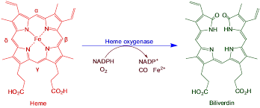

Slide 14
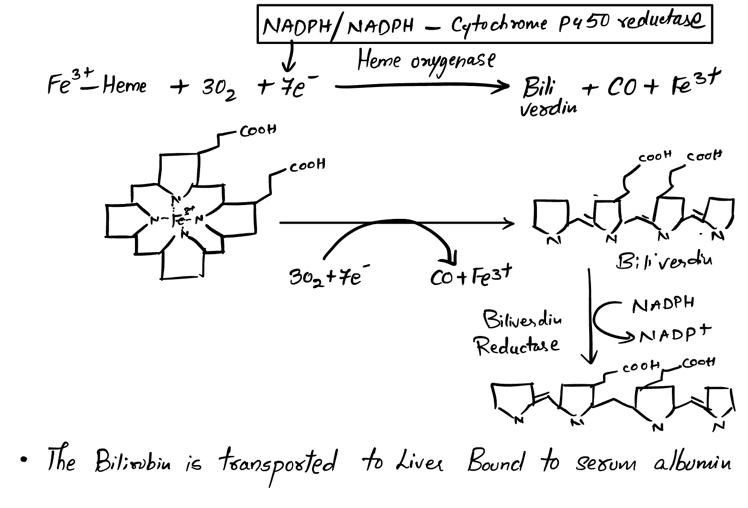

Slide 15
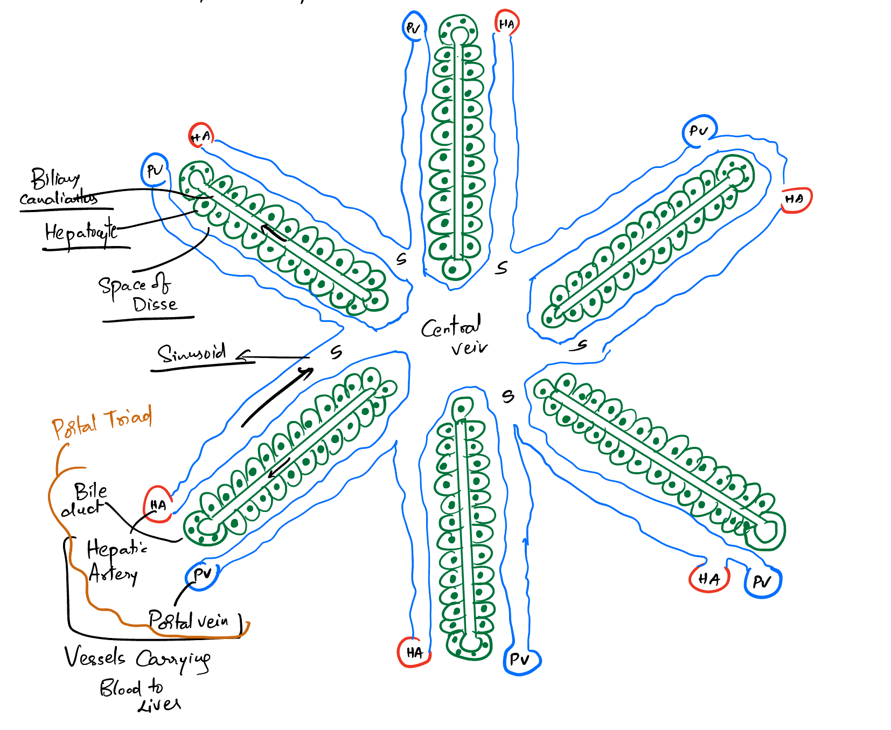

Slide 16
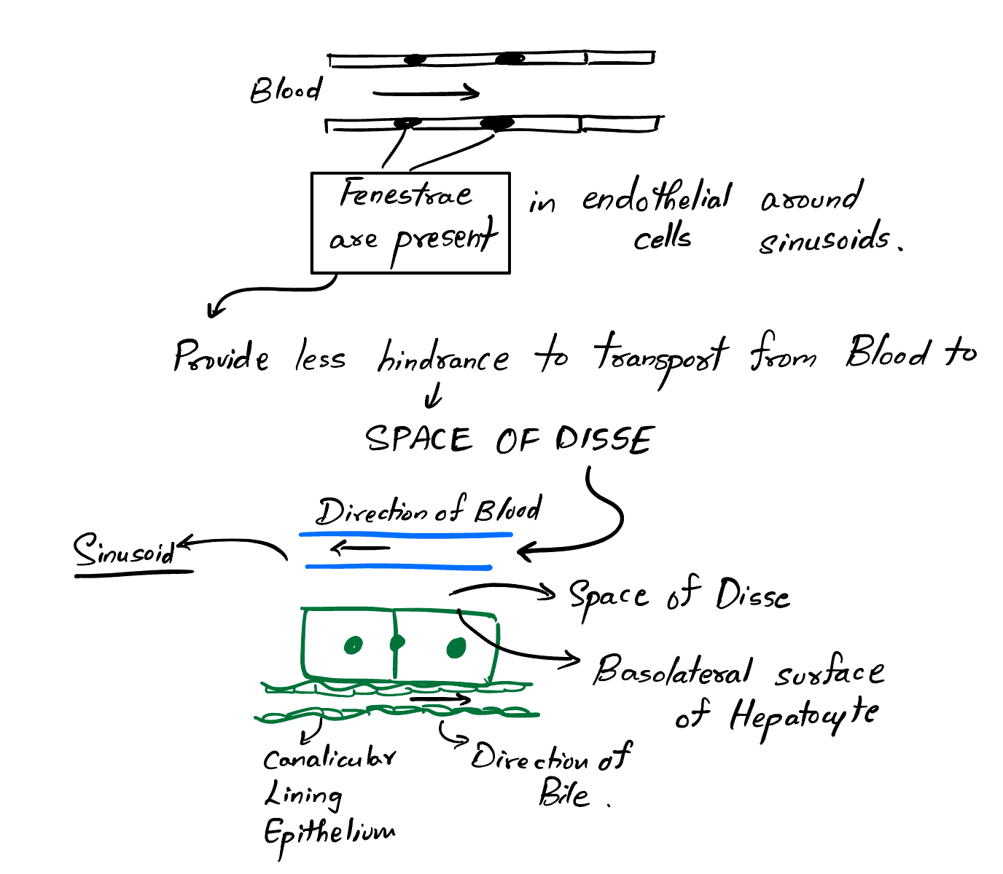

Slide 17
Bile composition
Water
Bile Acids
Bile Pigments
Cholestrol
Inorganic salts
Fatty acids
Phosphatidylcholine
Fat

Slide 18
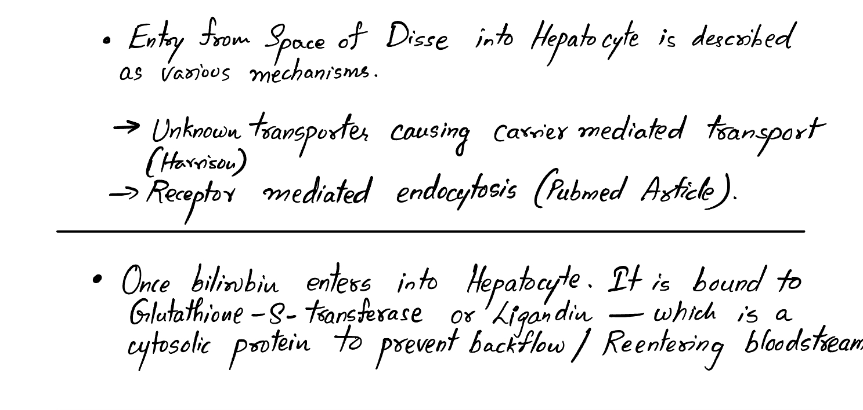

Slide 19
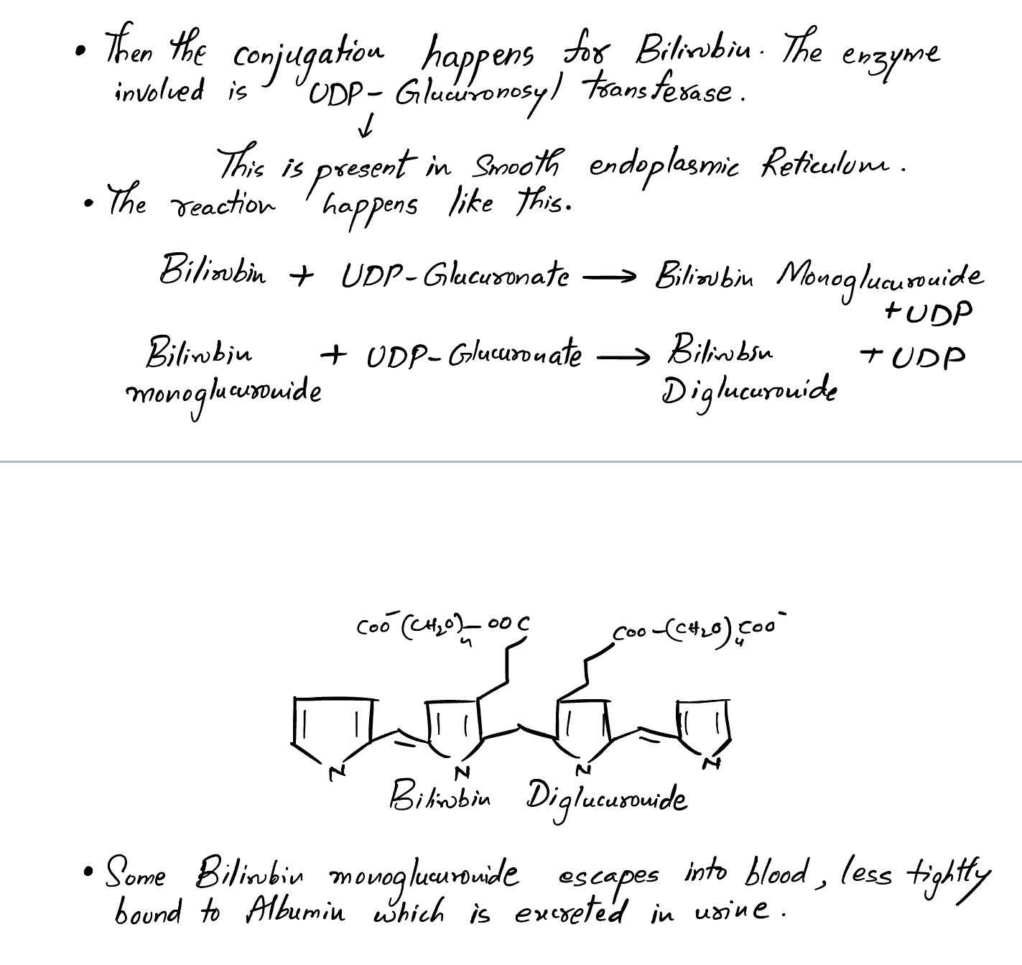

Slide 20
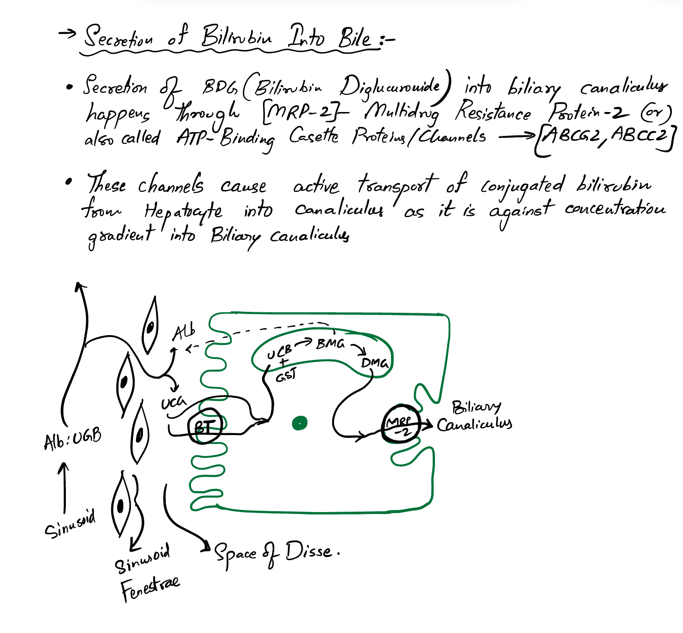

Slide 21
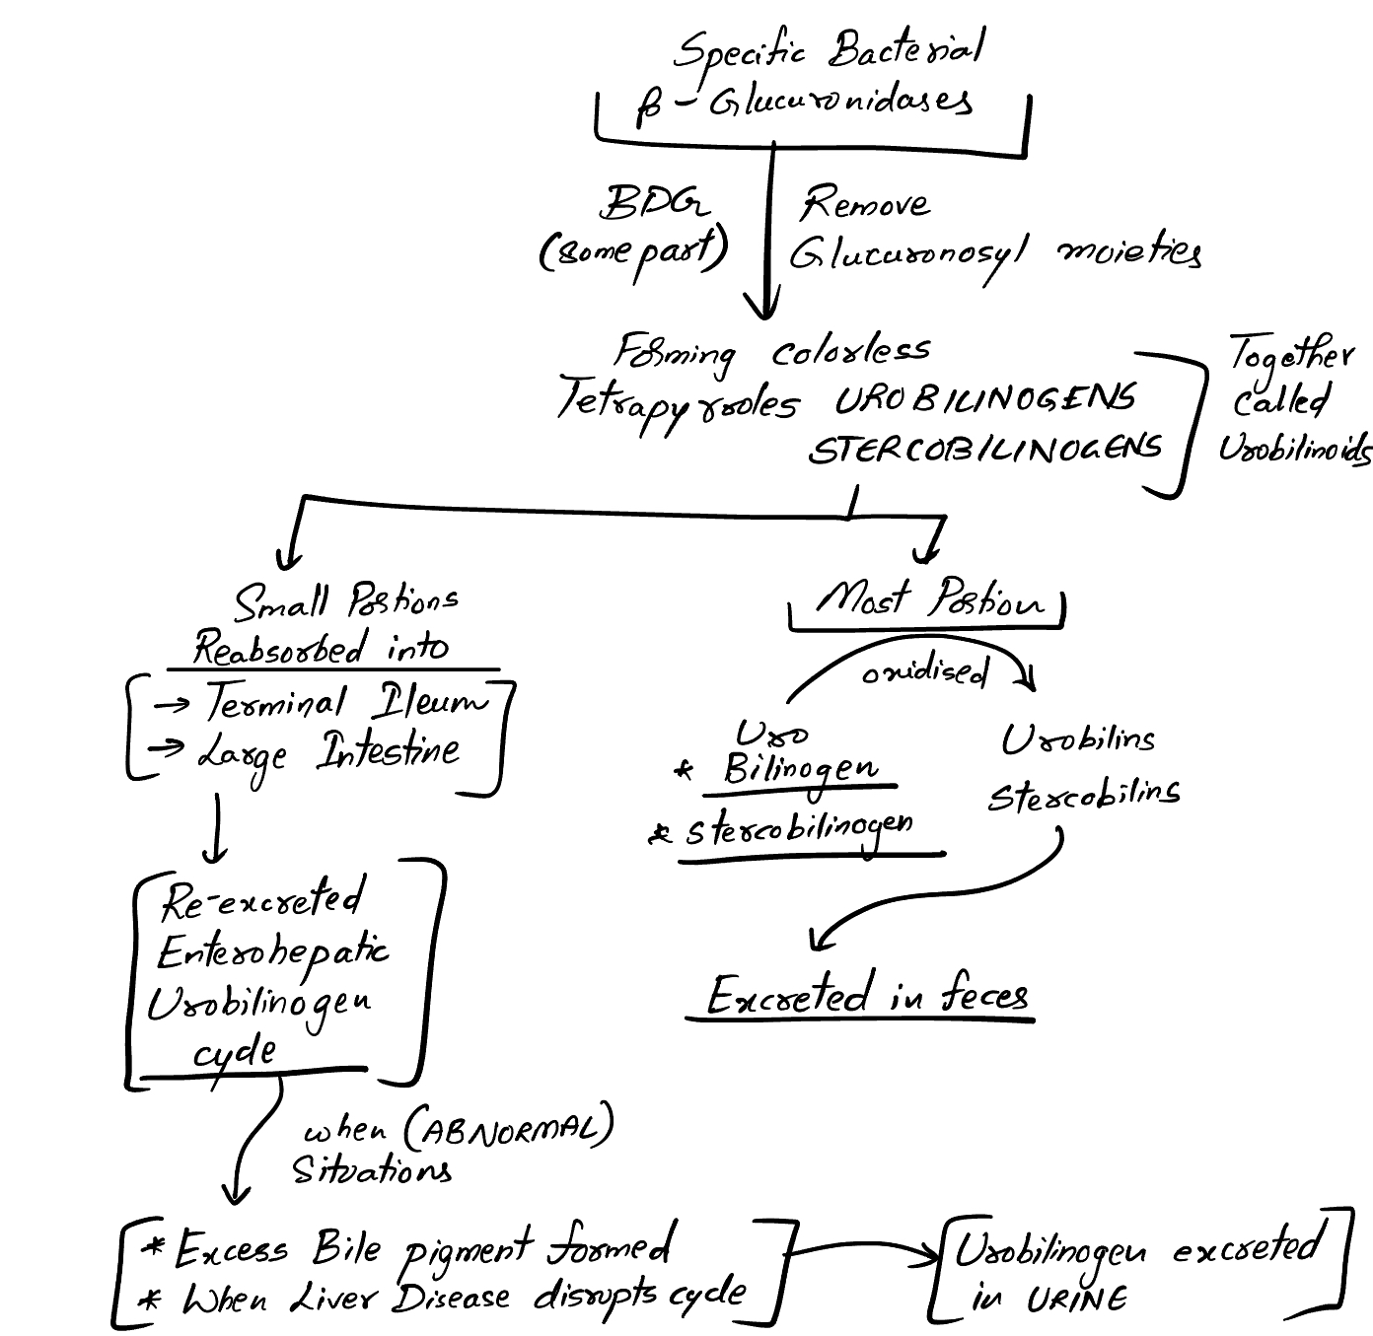

Slide 22
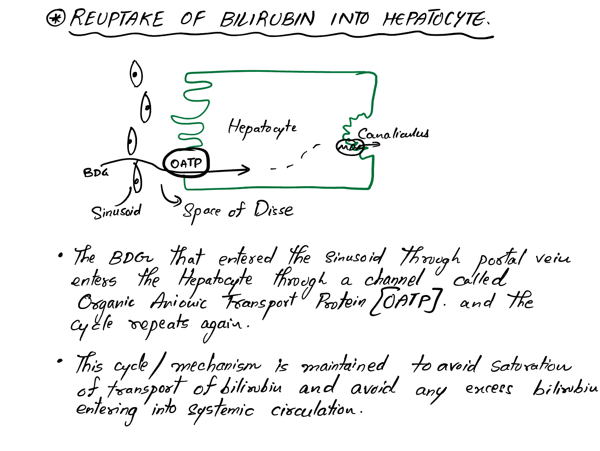

Slide 23
Thank You

